Slide 1
DuncanDSC530TermProject
Predicting the Originating Elevation of a Soil Sample

Slide 2
Elevation Prediction of Soil Sample
I want to analyze a data set from the USGS (United States Geological Survey) to ultimately conduct a regression model to predict what elevation a soil sample was taken.

Slide 3
Elevation Prediction of Soil Sample
Variables Used (Chapter 1)
lyr_top: Depth at the top of the soil layer (cm)
lyr_bot: "Depth at the bottom of the soil layer (cm)
lyr_mass: "Mass of the soil layer sample (g)
pro_depth_water: "Depth to the water table (cm)
pro_bedrock_depth: "Depth to bedrock (cm)
pro_elevation: Elevation of the soil sample location (m)

Slide 4
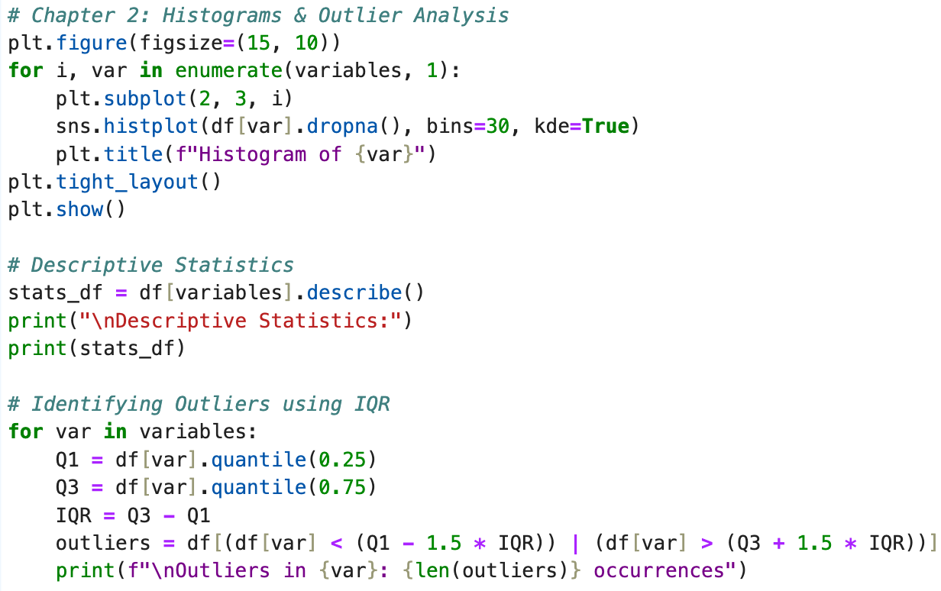
Elevation Prediction of Soil Sample Histograms (Chapter 2)

Slide 5
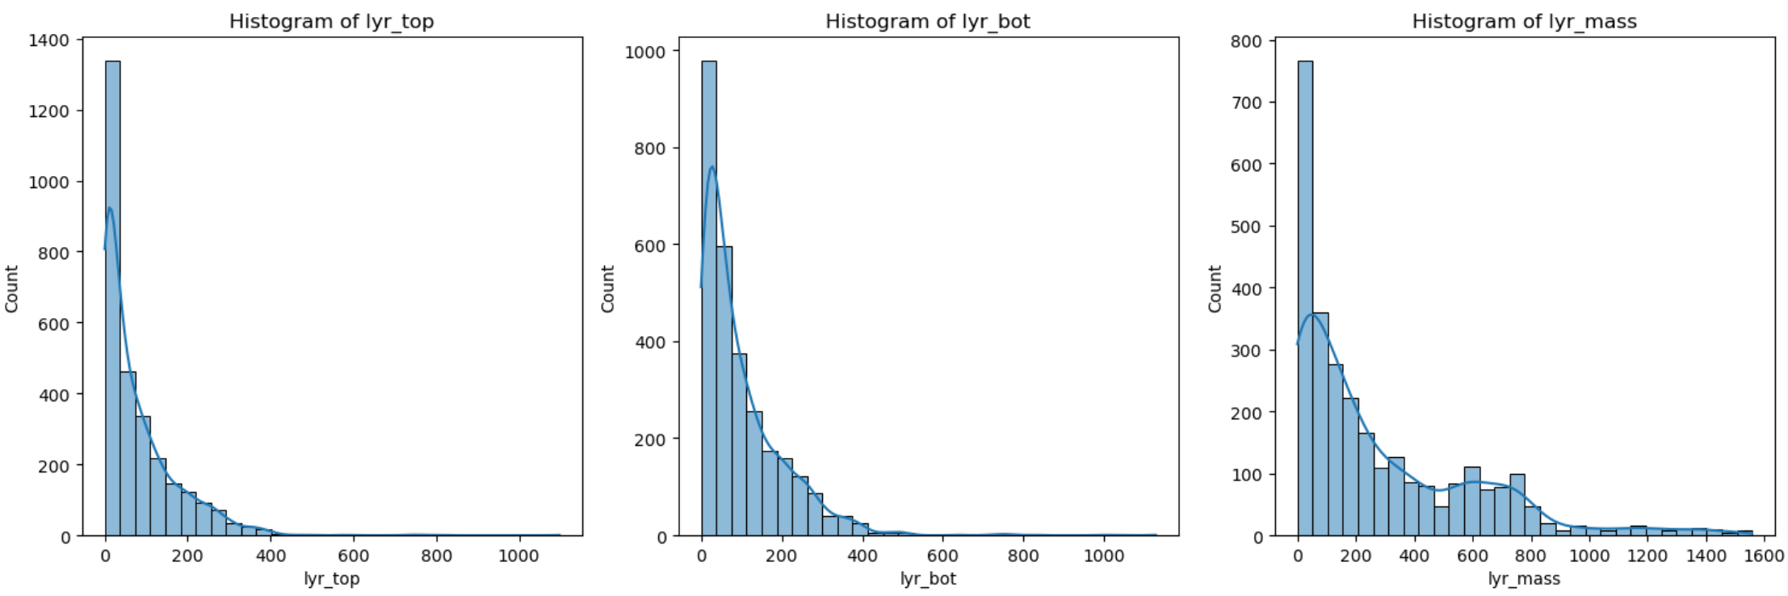
Elevation Prediction of Soil Sample Histograms (Chapter 2)

Slide 6
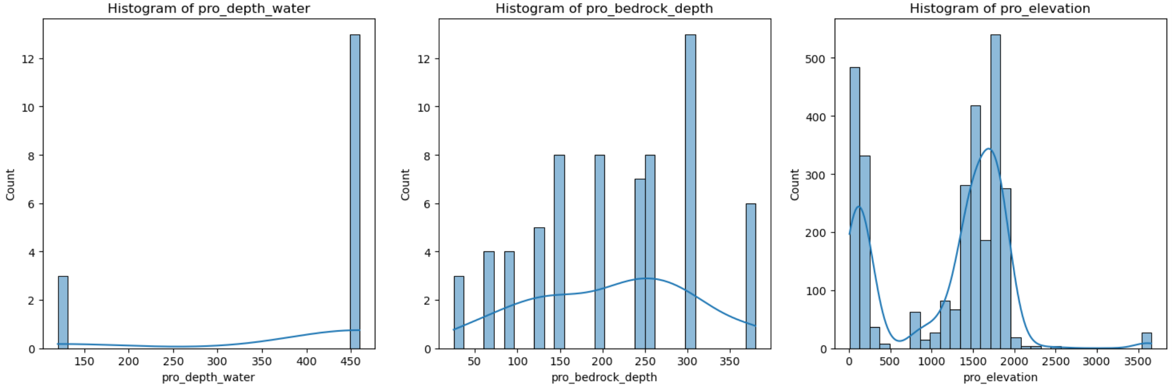
Elevation Prediction of Soil Sample Histograms (Chapter 2)

Slide 7
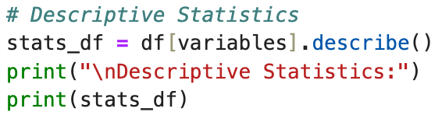
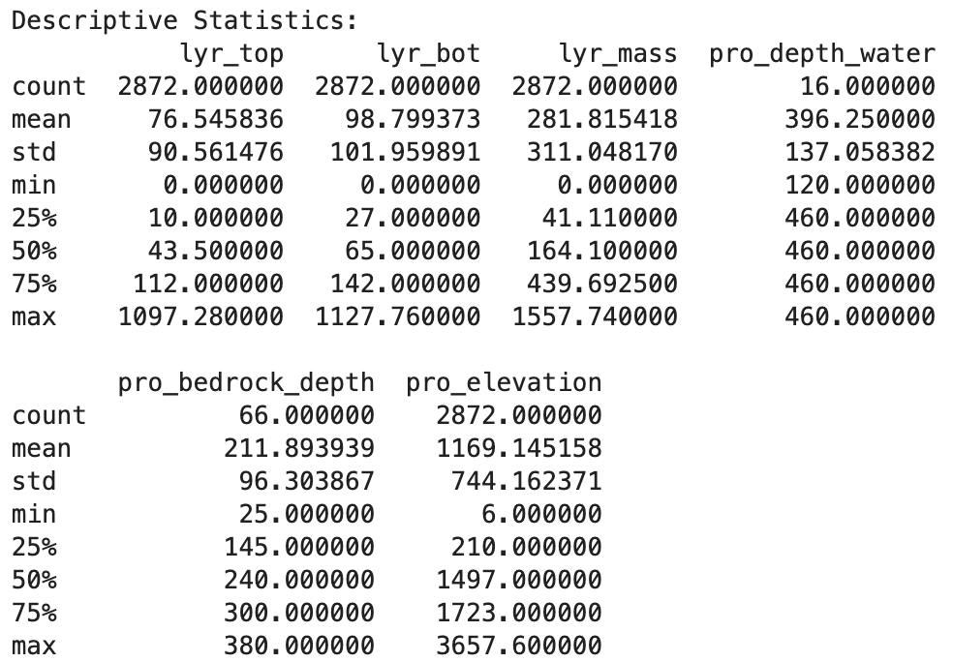
Elevation Prediction of Soil Sample Descriptive Stats (Chapter 2)

Slide 8
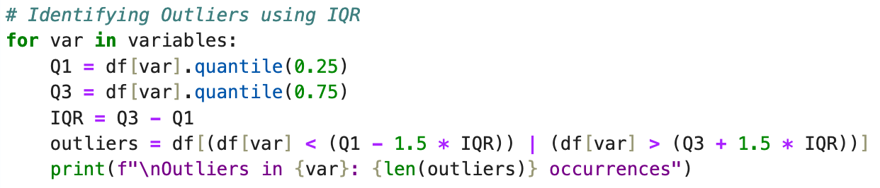
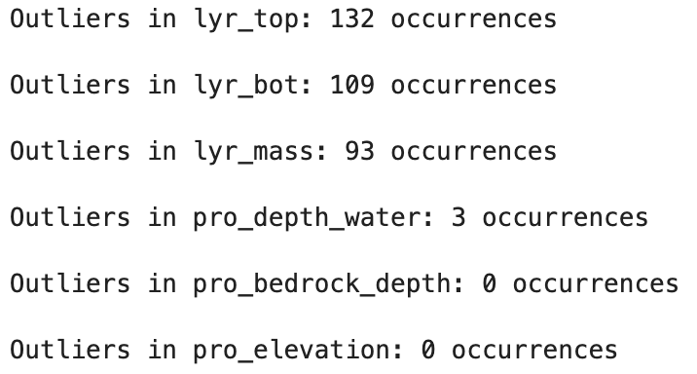
Elevation Prediction of Soil Sample Outliers (Chapter 2)

Slide 9
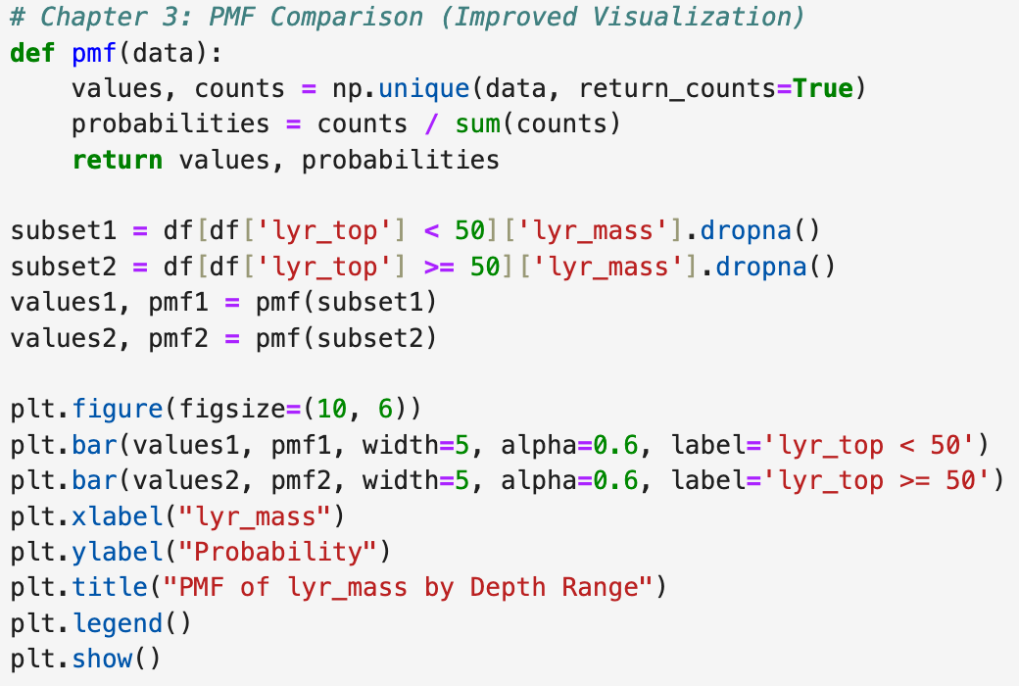
Elevation Prediction of Soil Sample PMF Comparison (Chapter 3)

Slide 10
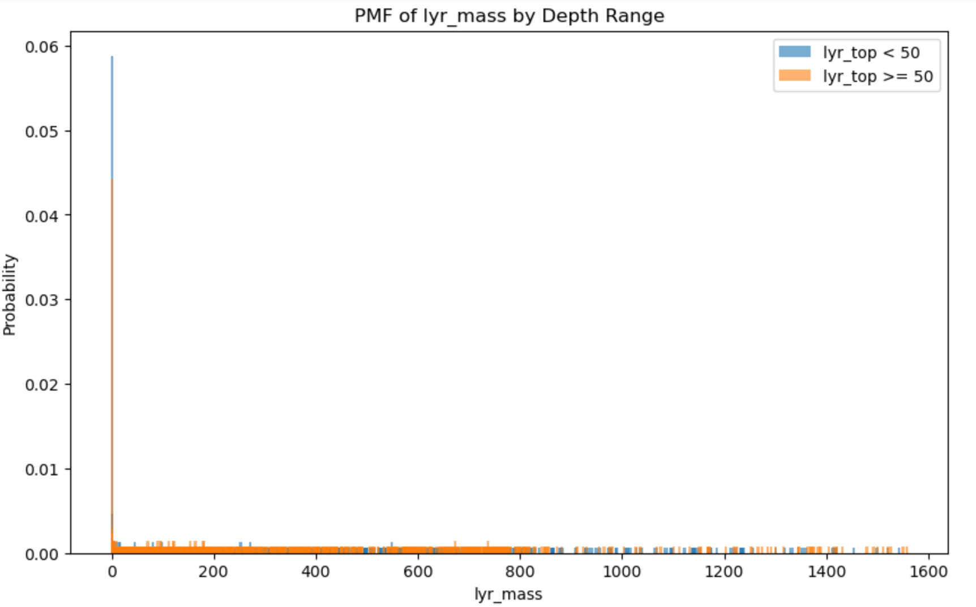
Elevation Prediction of Soil Sample PMF Comparison (Chapter 3)

Slide 11
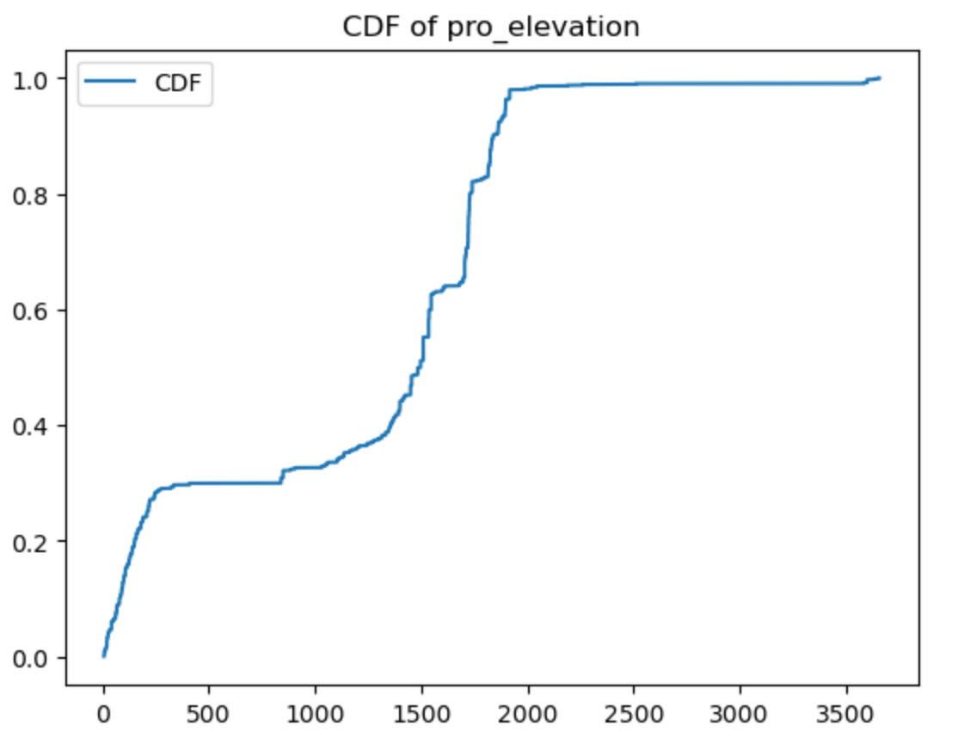
Elevation Prediction of Soil Sample CDF (Chapter 4)

Slide 12
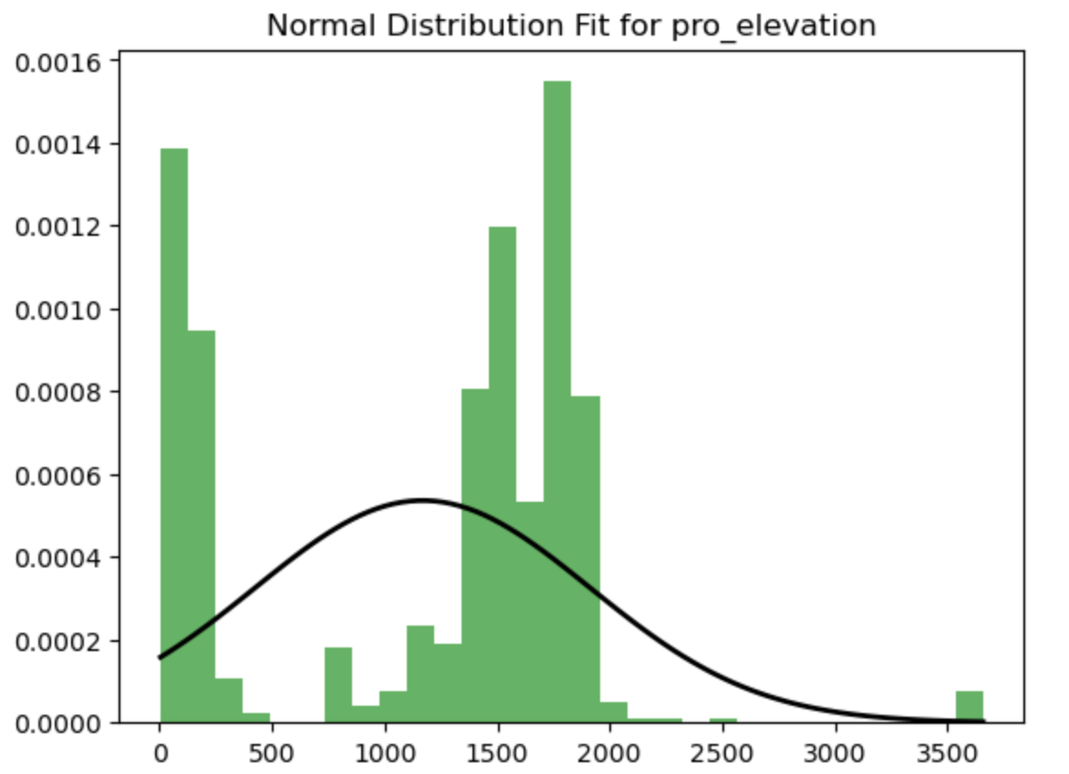
Elevation Prediction of Soil Sample Analytical Distribution (Chapter 5)

Slide 13
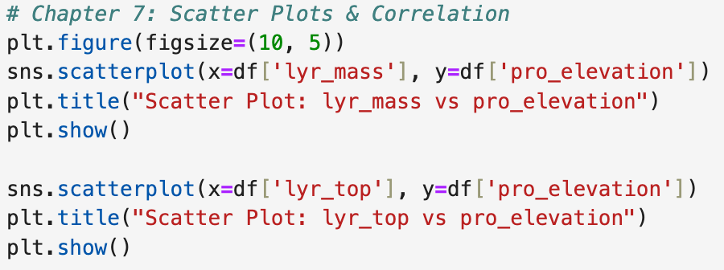
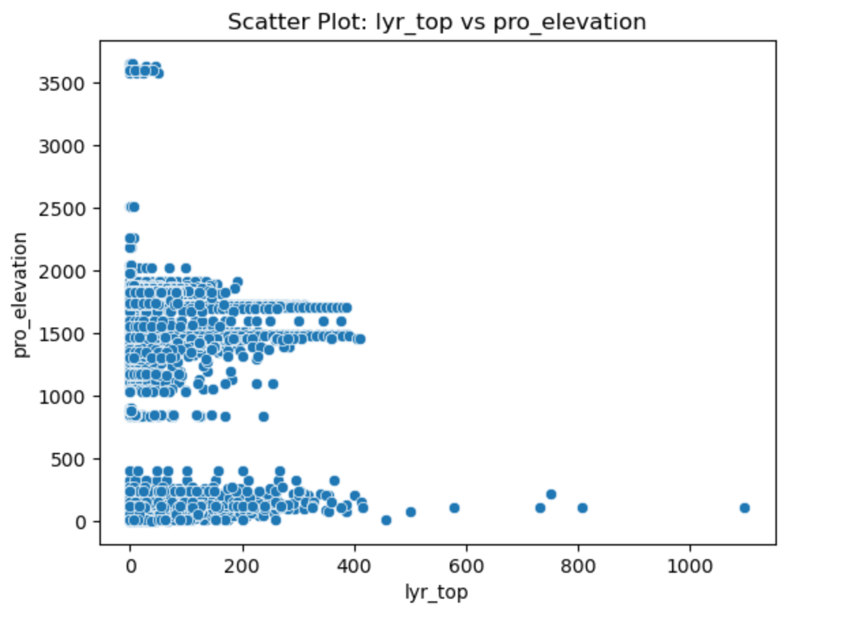
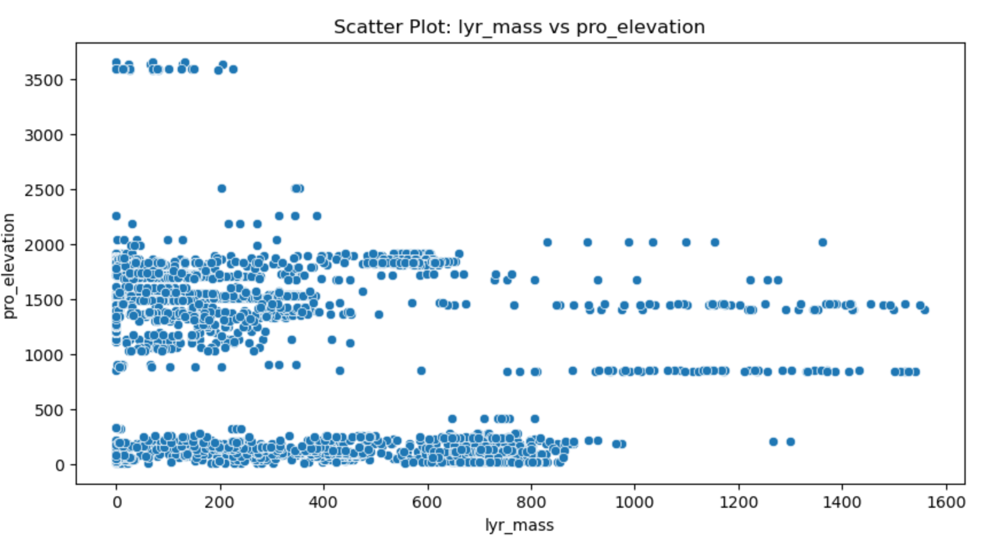
Elevation Prediction of Soil Sample Scatter Plots (Chapter 7)

Slide 14
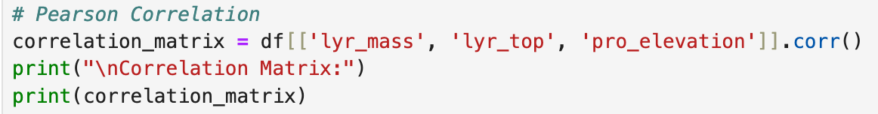
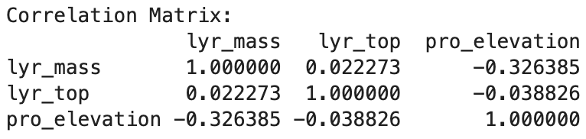
Elevation Prediction of Soil Sample Pearson Correlation (Chapter 7)

Slide 15
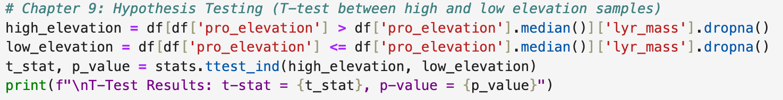
Elevation Prediction of Soil Sample Hypothesis Test (Chapter 9)

Slide 16
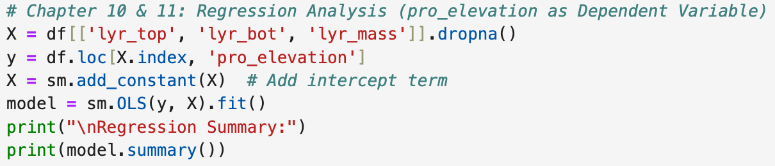
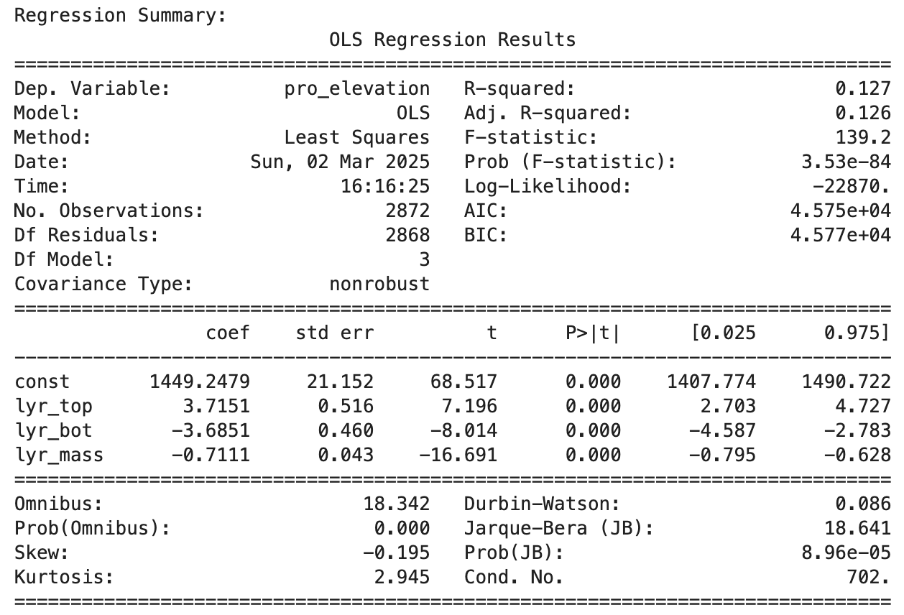
Elevation Prediction of Soil Sample Regression Model (Chapter 10 & 11)

